Slide 1

Force Directed Scheduling
Hardware Software Codesign
Summer Semester 2024
By : Pisula Guruge

Slide 2
Motivation

Slide 3

Force Directed Scheduling
Minimize total energy consumption.
Maintain resource limits and task dependencies.
Reduce the number of processors used.
Decrease simultaneous execution levels.
Maintain same execution duration. [1]

Slide 4
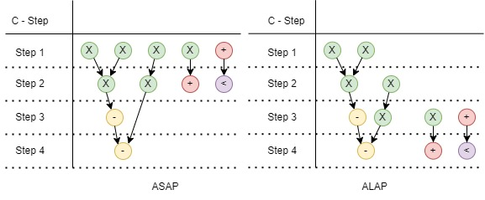
ASAP and ALAP SCHEDULING
Based on [1]

Slide 5

Hooke’s Law
Hooke’s Law states that the force required to extend or compress a spring is proportionate to the distance extended or compressed.
Hooke’s law is represented by the equation F=-kx.

Slide 6
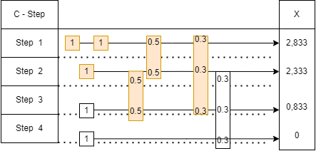
Diagram Flow graph(dfg)

Slide 7
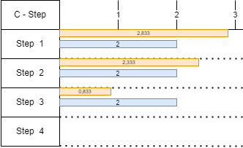
Comparison of initial and final Distribution graphs
In C-Step 1 : Force = 2.833*(1-0.5) + 2.333*(0-0.5)
= + 0.25
In C-Step 2 : F = 2.833*(0-0.5) + 2.333*(1-0.5)= - 0.25
In C-Step 2 : 2.333*(1-0.5) + 0.833*(0-0.5) = + 0.75
In C-Step 3 : 2.333*(0-0.5) + 0.833*(1-0.5) = - 0.75
In C-Step 1 : F = 2.833*(1-0.33) + 2.333*(0-0.33) + 0.833*(0-0.33) = + 0.853
In C- Step 2 : F =2.833*(0-0.33)+2.33*(1-0.33)+0.833*(0-0.33)=0.351

Slide 8

summary
Optimization: FDS minimizes conflicts and enhances resource utilization through force simulation.
Flexibility: Allows dynamic adjustments to accommodate changes and uncertainties.
Visualization: Provides real-time visual adaptation for better analysis and response.

Slide 9
References
[1] Lee, E. T., Schrage, J. B. (1974). An algorithm for scheduling independent tasks. Operations Research, 22, 458-475.
[2] Johnson, R. G. (1983). Heterogeneous parallel processing. Communications of the ACM, 26, 832-844.
[3] Brandenburg, F. Force Directed Scheduling: A Survey. Journal of Scheduling, 15(1), 2012, pp. 3-24.
[4] Liu, J. W. S. (2000). Real-Time Systems. Prentice Hall.
[5] Kress, R., Thiele, L. (2002). Models and Algorithms for Embedded Real-Time Systems. Springer.
[6] P. G. Pauline and J. P. Knight, ”Force-Directed Scheduling in Automatic Data Path Synthesis,” 24th ACM/IEEE Design Automation Conference, Miami Beach, FL, USA, 1987, pp.195-202, doi: 10.1145/37888.37918.
[7] Scheduling Algorithms for High-Level Synthesis Zoltan Baruch Computer Science Department, Technical University of Cluj-Napoca , URL - http://users.utcluj.ro/ baruch/papers/ Scheduling-Algorithms.pdf
[8] Micheli, Giovanni. Synthesis and Optimization of Digital Circuits. McGraw-Hill Professional, 1994.

